Slide 1
数据归一化
王宗尧
E-mail: wzy@dlmu.edu.cn

Slide 2



Normalization
The height of someone can be 1.7 or 170 or 1700 …
Min-max normalization:
Let income range $12,000 to $98,000 be normalized to [0.0, 1.0]. Then $73,600 is mapped to
Z-score normalization (μ: mean, σ: standard deviation):
Let μ = 54,000, σ = 16,000. Then
$$v^{′}=\frac{v−min}{max−min} \left(new_max−new_min\right)+new_min$$
$$v^{′}=\frac{v−μ}{σ}$$

Slide 3
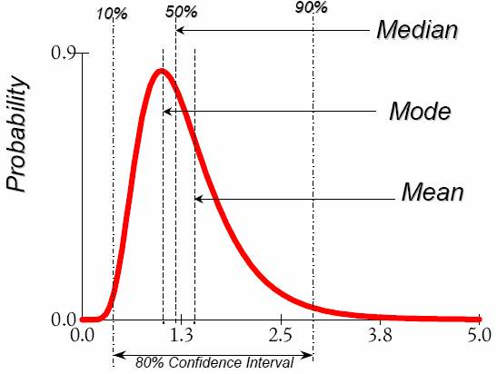




Data Description
Mean
Arithmetic mean
Median
Mode
The most frequently occurring value in a list
Can be used with non-numerical data.
Variance
Degree of diversity
$$\overline{x}=\frac{1}{n}\sum_{i=1}^{n}{x_{i}}=\frac{1}{n}\left(x_{1}+…+x_{n}\right)$$
$$P\left(X≤m\right)=P\left(X≥m\right)=\int_{−∞}^{m}{f\left(x\right)dx=}\frac{1}{2}$$
$$Var\left(X\right)=\int{{\left(x−μ\right)}^{2}f\left(x\right)dx}$$
$$Var\left(X\right)=E\left[{\left(X−μ\right)}^{2}\right]$$

Slide 4
请看实例4

Slide 5
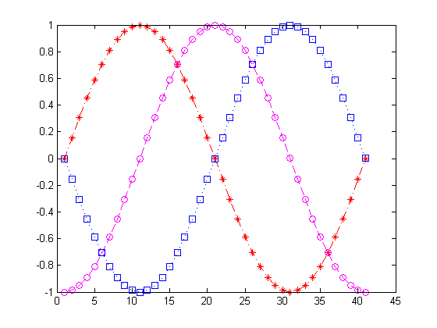
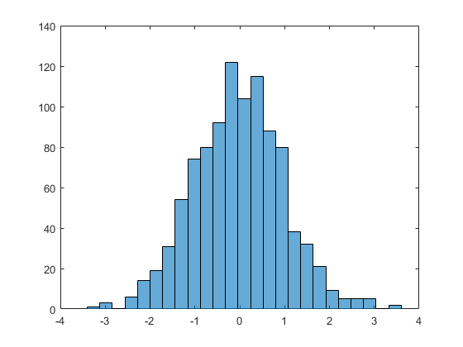
Data Visualization (1D)

Slide 6
Data Visualization (2D)
Notes:
load carsmall
plot(Displacement, Acceleration,'ro')
regress(Acceleration,[ones(100,1),Displacement])
hold on
line([0,19.35/0.021],[19.35,0])

Slide 7
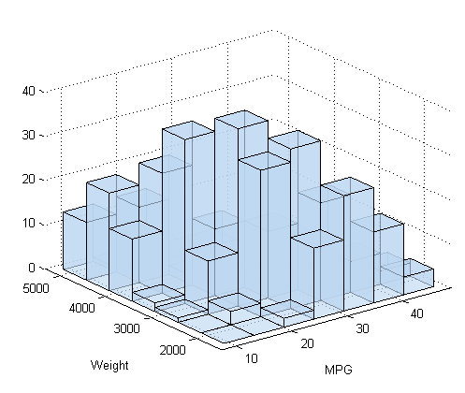
Surf Plots (3D)
Notes:
[X,Y]=meshgrid(-3:0.1:3,-3:0.1:3);
Z=peaks(X,Y);
surfc(X,Y,Z);
shading interp
colormap(gray);

Slide 8
请看example5，example6

Slide 9
PCA降维

Slide 10
先看看example_pca0

Slide 11
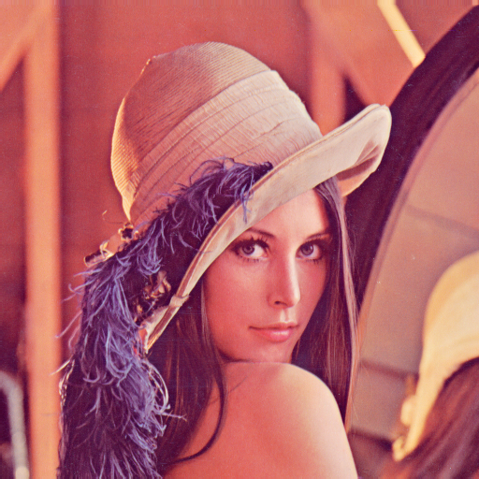
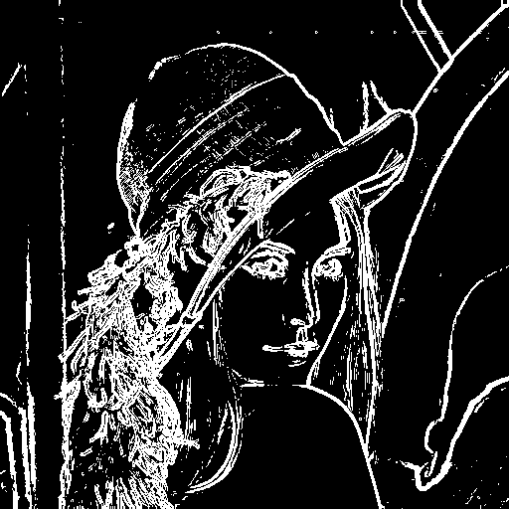
Feature Extraction

Slide 12

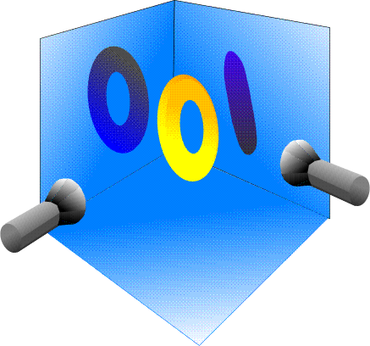
Principal Component Analysis

Slide 13
2D Example
Data: Gaussian Distribution
Variance: Information
Ellipse: Major Axis vs. Minor Axis
Select the attribute corresponding to the Major Axis.
Minor
Major
Feature X₂
Feature X₁

Slide 14
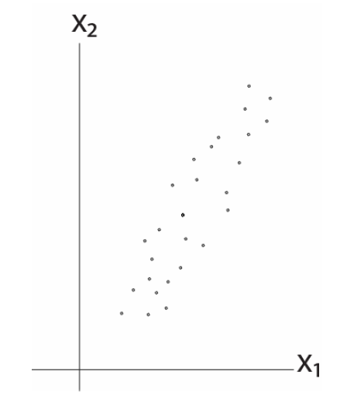
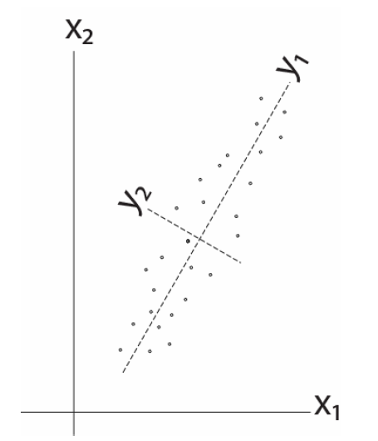
2D Example

Slide 15
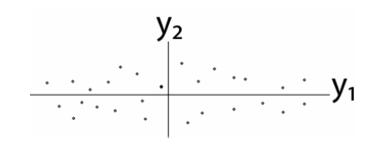
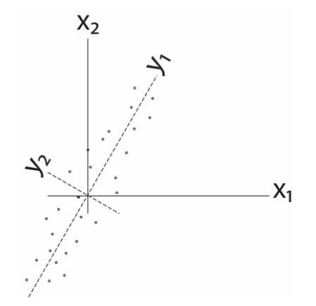
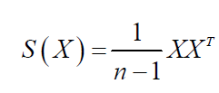

2D Example
Remove correlation

Slide 16
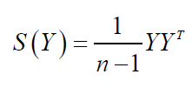
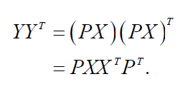

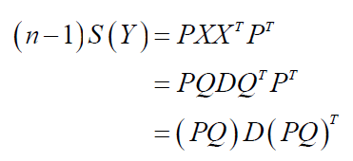


Some Math
Goal: S(Y) has nonzero diagonal entries and all off-diagonal elements are zero.
Eigendecomposition

Slide 17
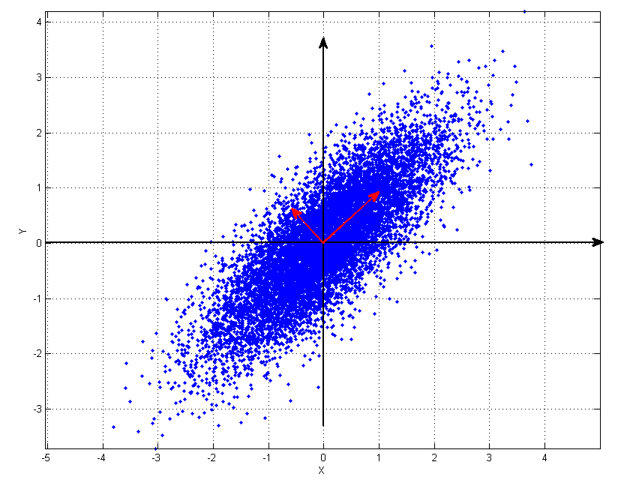
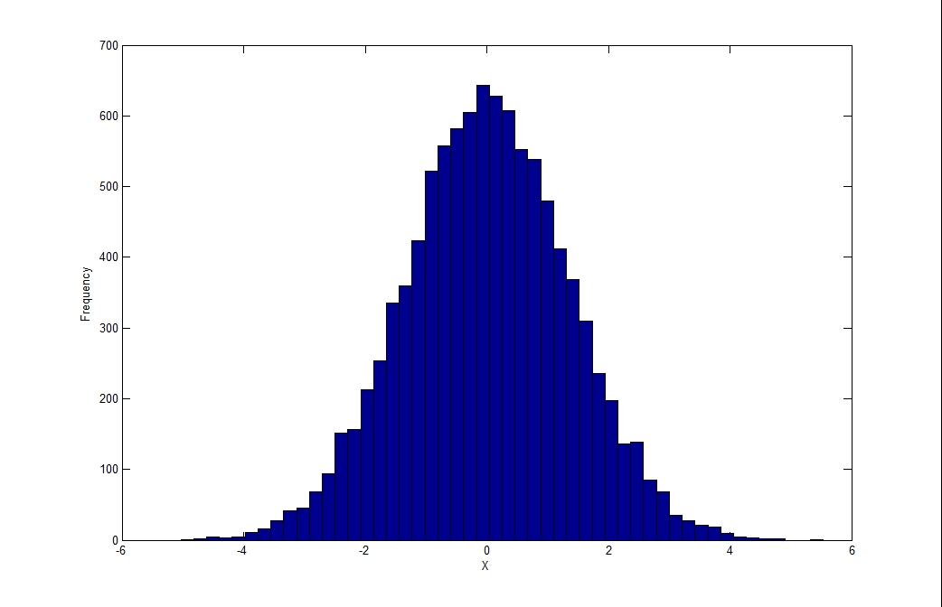
PCA Examples

Slide 18
请看example_pca1

Slide 19

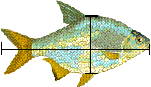
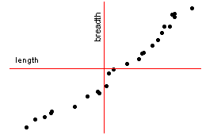
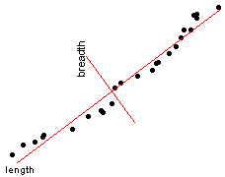
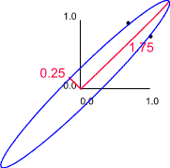
Fish

Slide 20

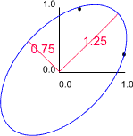
Fish

Slide 21
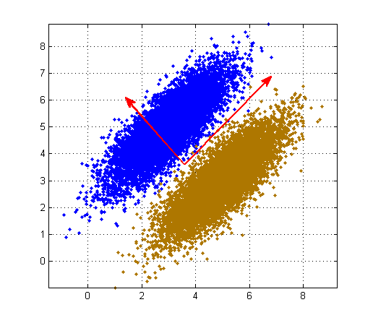
The Issue of PCA
Now, let’s consider class information ...

Slide 22
最后再看看 example_pca2，example_pca3

Slide 23
Reading Materials
M. A. Hernandez and S. J. Stolfo, “Real-World Data is Dirty: Data Cleansing and The Merge/Purge Problem,” Data Mining and Knowledge Discovery, vol. 2, pp. 9–37, 1998.
A. Donders, G. van der Heijden, T. Stijnen, and K. Moons, “Review: A Gentle Introduction to Imputation of Missing Values,” Journal of Clinical Epidemiology, vol. 59, pp. 1087-1091, 2006.
N. V. Chawla, K. W. Bowyer, L. O. Hall and W. P. Kegelmeyer, “SMOTE: Synthetic Minority Over-Sampling Technique,” Journal of Artificial Intelligence Research, vol. 16, pp. 321–357, 2002.
N. Japkowicz and S. Stephen, “The Class Imbalance Problem: A Systematic Study,” Intelligent Data Analysis, vol. 6, pp. 429–449, 2002.
D. Keim, “Information Visualization and Visual Data Mining,” IEEE Transactions on Visualization and Computer Graphics, vol. 8, pp. 1-8, 2002.
PCA Tutorials
http://www.cs.princeton.edu/picasso/mats/PCA-Tutorial-Intuition_jp.pdf
http://www.cs.otago.ac.nz/cosc453/student_tutorials/principal_components.pdf
Lagrange Multipliers
http://diglib.stanford.edu:8091/~klein/lagrange-multipliers.pdf

Slide 24
Python数据爬虫

Slide 25
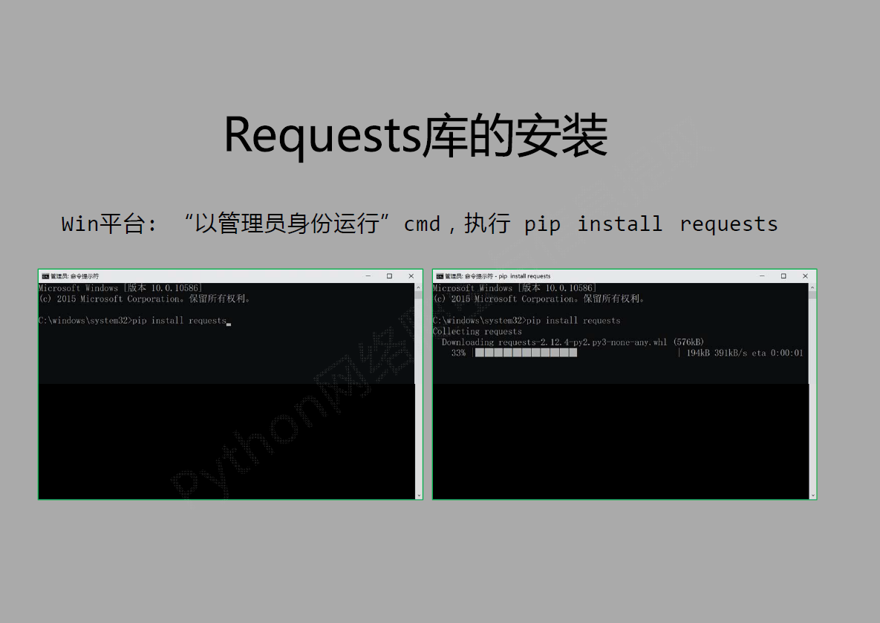

Slide 26
第一个例子请看example_webworm1

Slide 27
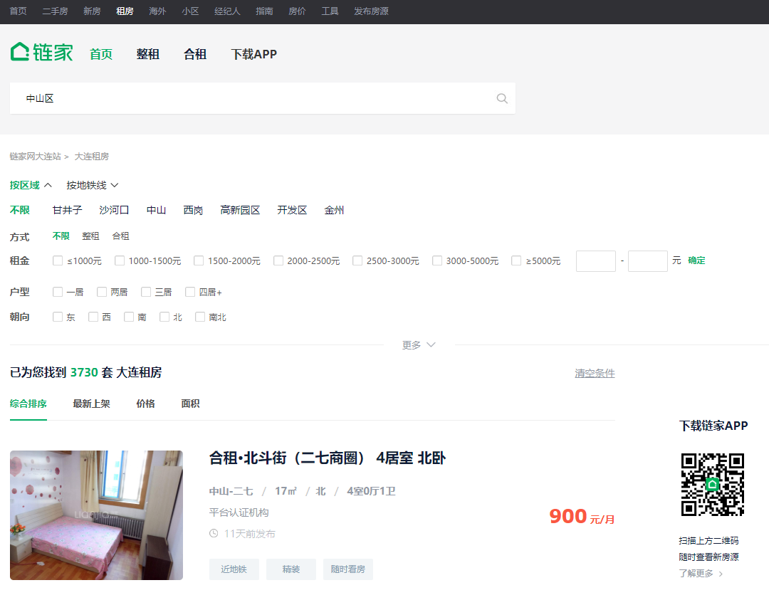
数据定向爬取
获取链家网某一区域的房屋价格信息

Slide 28
分析网址
在链家网搜索‘中山区’，获取第一页、第二页、第三页网址：
https://dl.lianjia.com/zufang/rs中山区/
https://dl.lianjia.com/zufang/pg2rs中山区#contentList
https://dl.lianjia.com/zufang/pg3rs中山区/#contentList
https://dl.lianjia.com/zufang/pg4rs中山区/#contentList

Slide 29
第二个例子请看example_webworm2

Slide 30
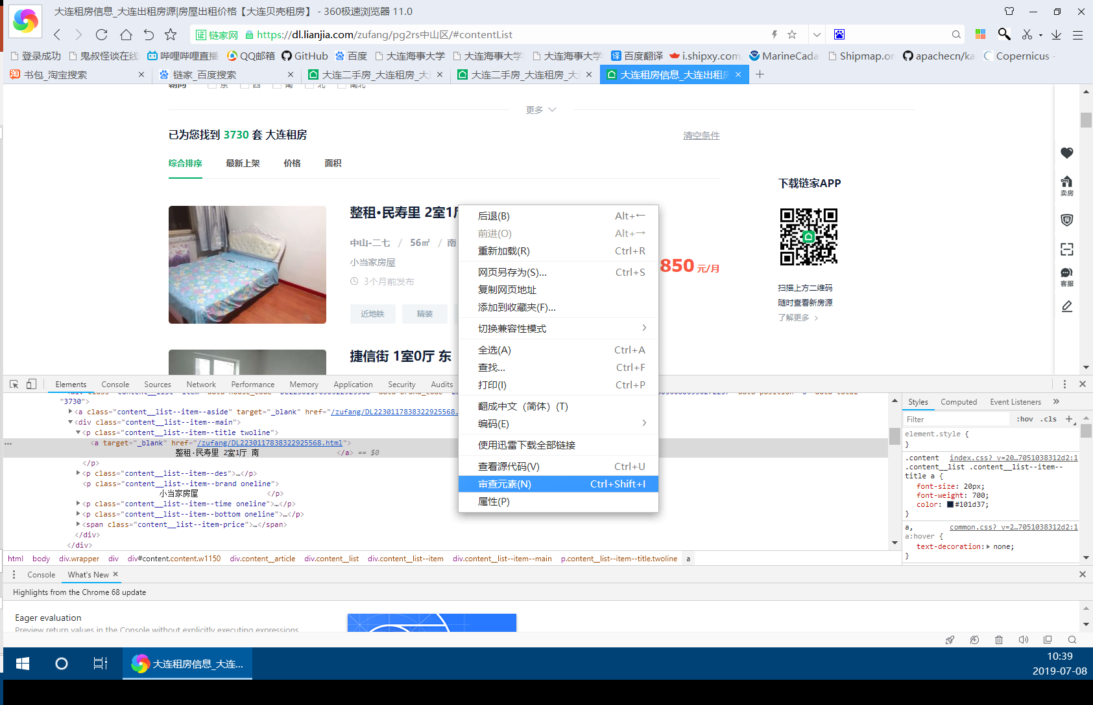
获取网页元素
右键点击网页上需要抓取的元素，查看其标签性质

Slide 31
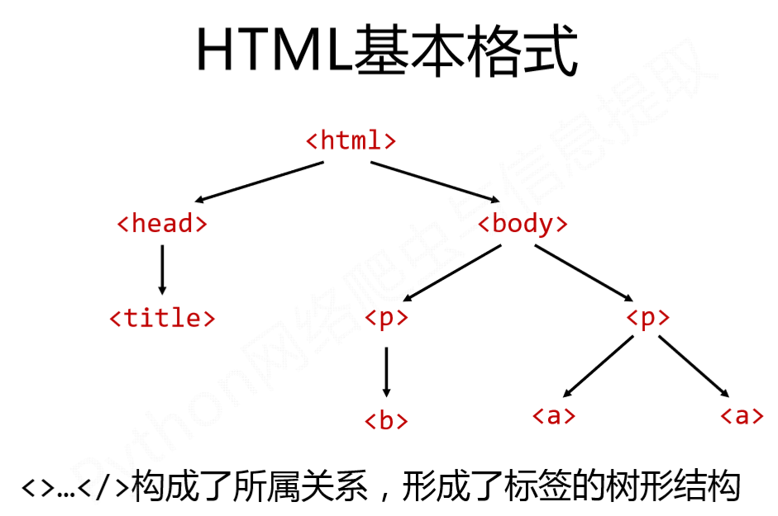

Slide 32
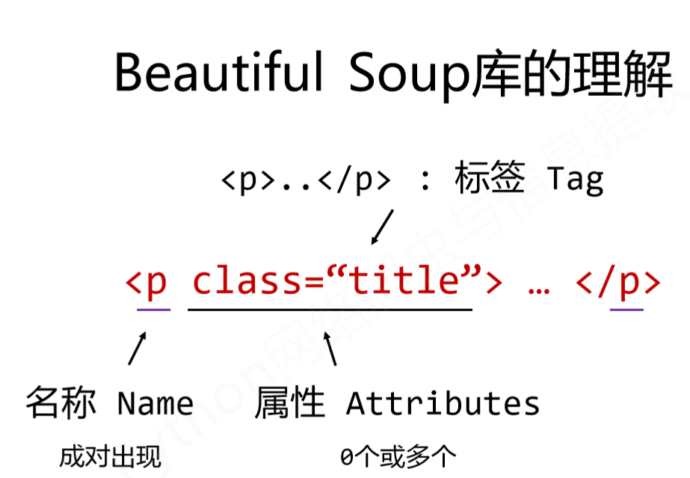

Slide 33
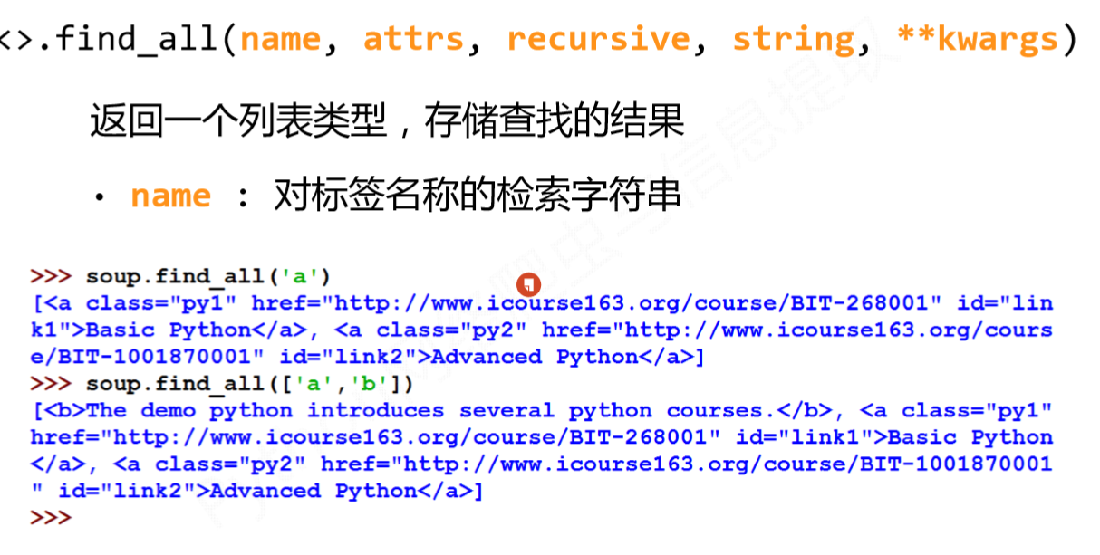

Slide 34
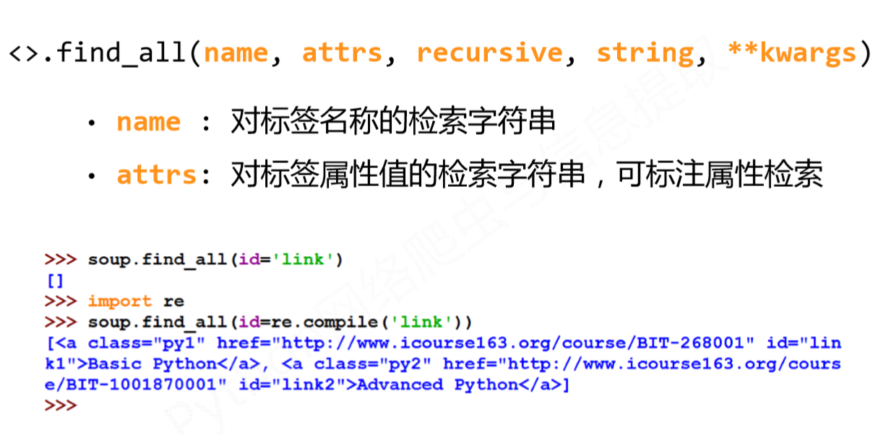

Slide 35
开始爬吧，请看example_webworm3

